Slide 1
Announcements
Project 0: Python Tutorial
Due Friday at 5pm
Math self-diagnostic on web --- optional, but important to check your preparedness for second half
Sections
Sign-up Friday at 2pm on piazza
Start next week, can go to any, but have priority in your own
Instructional accounts: after lecture, but not needed except if you use lab machines

Slide 2

CS 370: Artificial Intelligence
Search
Instructors: William DeMeo
New Jersey Institute of Technology
[These slides were created by Dan Klein and Pieter Abbeel for CS188 Intro to AI at UC Berkeley. All CS188 materials are available at http://ai.berkeley.edu.]
Notes:
Please retain proper attribution, including the reference to ai.berkeley.edu. Thanks!

Slide 3
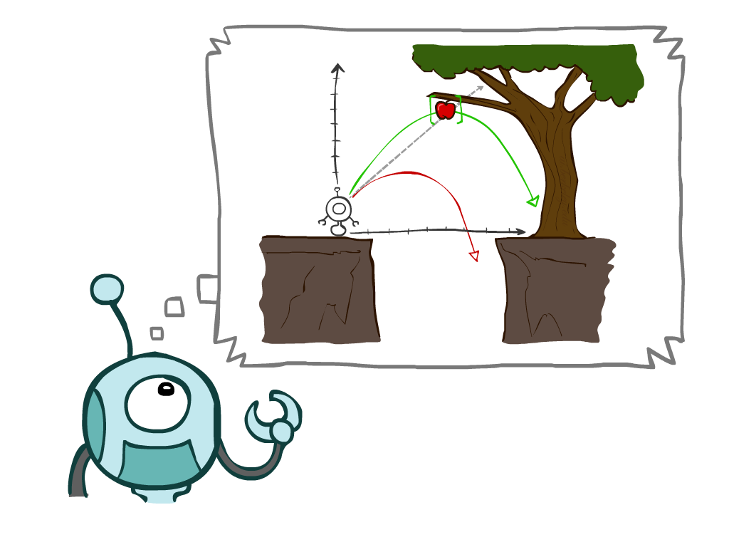
Today
Agents that Plan Ahead
Search Problems
Uninformed Search Methods
Depth-First Search
Breadth-First Search
Uniform-Cost Search
Notes:
General theme in the class:
A goal we have in mind.
A mathematical abstraction to formalize this
Algorithms that operate on these abstractions
(Uniform-cost search is aka Dijkstra’s algorithm... but our presentation may be different.)
Recall, a rational agent is one whose actions maximize the expected utility function.

Slide 4
Agents that Plan
Notes:
It may seem obvious that to solve most problems we need to plan ahead, and in fact that’s what we humans do all the time... But for some problems it may not seem like the obvious thing to do. e.g., Roomba robot vacuum. You might just program it with the instructions “look for dirt, move to dirt, clean up dirt” with no need for simulating. We have a name for agents that behave this way: Reflex agents.

Slide 5

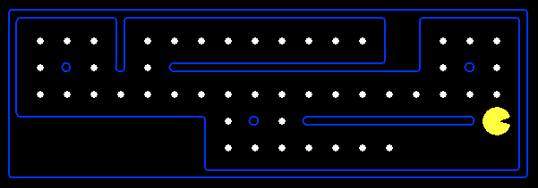
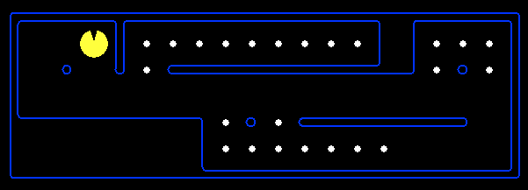
Reflex Agents
Reflex agents:
Choose action based on current percept (and maybe memory)
May have memory or a model of the world’s current state
Do not consider the future consequences of their actions
Consider how the world IS
Can a reflex agent be rational?
[Demo: reflex optimal (L2D1)]
[Demo: reflex optimal (L2D2)]
Notes:
Examples: blinking your eye (not using your entire thinking capabilities), vacuum cleaner moving towards nearest dirt. A reflex agent doesn’t plan ahead.

Slide 6

Video of Demo Reflex Optimal
Notes:
Reflex agent function: Take a step in the direction of the nearest dot. For this environment, such a reflex agent is rational.

Slide 7
Video of Demo Reflex Odd
Notes:
An example environment where the same reflex agent is not rational.
To fix this, we would like to look four steps into the future.
Moving East gets me no closer to the dot (because of the wall), but if I move South, East, East, West, North I get to eat more dots.

Slide 8
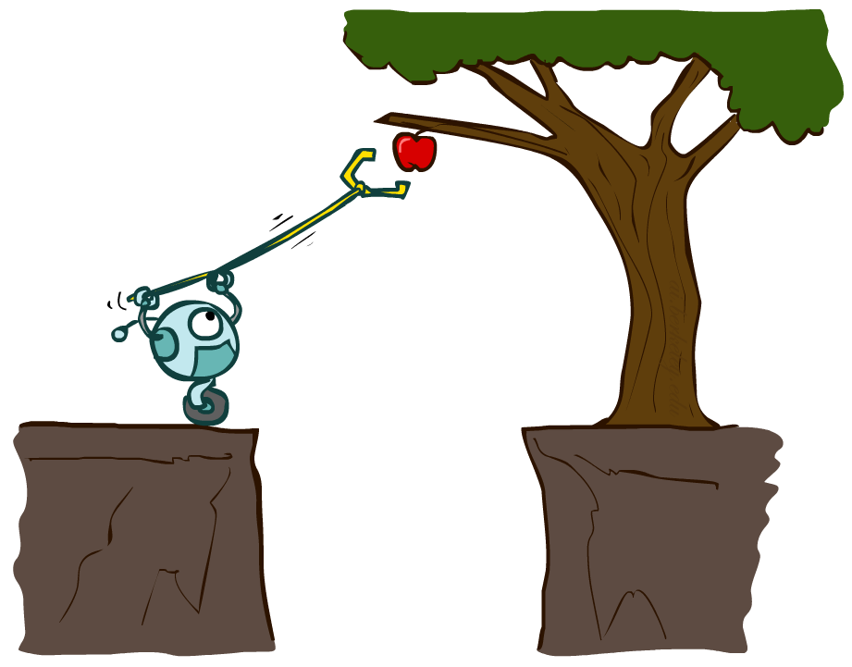
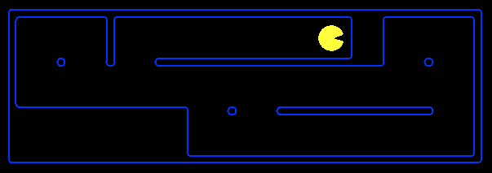
Planning Agents
Planning agents:
Ask “what if”
Decisions based on (hypothesized) consequences of actions
Must have a model of how the world evolves in response to actions
Must formulate a goal (test)
Consider how the world WOULD BE
Optimal vs. complete planning
Planning vs. replanning
[Demo: replanning (L2D3)]
[Demo: mastermind (L2D4)]
Notes:
Optimality: If there are multiple paths to a goal, are we selecting the best one?
Completeness: If there exists a solution, does our algorithm (agent) find it?
Planning: We can see all the way along a path to our final goal.
Replanning: We define some intermediate goals such that, if we achieve all of them, we will achieve the final goal.

Slide 9
Video of Demo Replanning

Slide 10
Video of Demo Mastermind

Slide 11

Search Problems

Slide 12

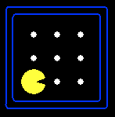





Search Problems
A search problem consists of:
A state space
A successor function
(with actions, costs)
A start state and a goal test
A solution is a sequence of actions (a plan) which transforms the start state to a goal state
“N”, 1.0
“E”, 1.0
Notes:
Goal test – sometimes more than one state that satisfies having achieved the goal, for example, “eat all the dots”
Abstraction

Slide 13

Search Problems Are Models
Abstraction
Notes:
Abstraction is necessary in order to for our models to be useful. In order for our program to be computable or “effective” or “tractable,” we must omit any data or features of the environment that are inessential or irrelevant.
Consequently, our models are not perfect reflections of the real world. We sometimes get weird results, and it’s usually a problem with the model, not the search algorithm.

Slide 14
Example: Traveling in Romania
State space:
Cities
Successor function:
Roads: Go to adjacent city with cost = distance
Start state:
Arad
Goal test:
Is state == Bucharest?
Solution?
Notes:
Start in Arad. Trying to get to Bucharest. Cost: time required to traverse the route

Slide 15
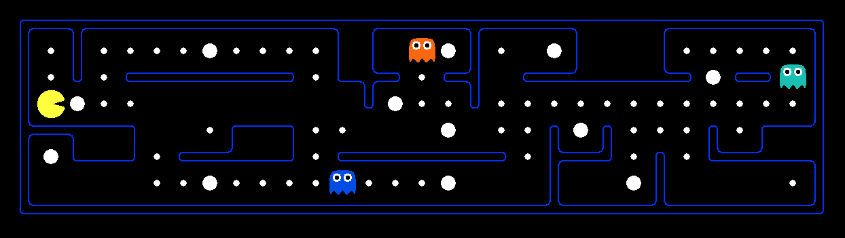
What’s in a State Space?
The world state includes every last detail of the environment
A search state keeps only the details needed for planning (abstraction)
Problem: Pathing
States: (x,y) location
Actions: NSEW
Successor: update location only
Goal test: is (x,y)=END
Problem: Eat-All-Dots
States: {(x,y, dot count)}
Actions: NSEW
Successor: update location and possibly a dot boolean
Goal test: dots all false

Slide 16
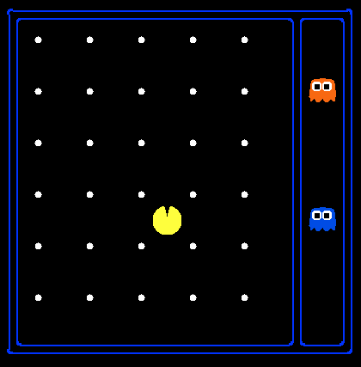
State Space Sizes?
World state:
Agent positions: 120
Food count: 30
Ghost positions: 12
Agent facing: NSEW
Notes:
90 * (2^30-1) + 30 * 2^29 = 145 billion
2^29 = 536 870 912

Slide 17
State Space Sizes?
World state:
Agent positions: 120
Food count: 30
Ghost positions: 12
Agent facing: NSEW
How many
World states?
120x(2³⁰)x(12²)x4
States for pathing?
120
States for eat-all-dots?
120x(2³⁰)
Notes:
90 * (2^30-1) + 30 * 2^29 = 145 billion
2^29 = 536 870 912

Slide 18
Quiz: Safe Passage
Problem: eat all dots while keeping the ghosts perma-scared.
What does the state space have to specify?

Slide 19
Quiz: Safe Passage
Problem: eat all dots while keeping the ghosts perma-scared.
What does the state space have to specify?
Answer: agent position, dot booleans, power pellet booleans, remaining scared time

Slide 20
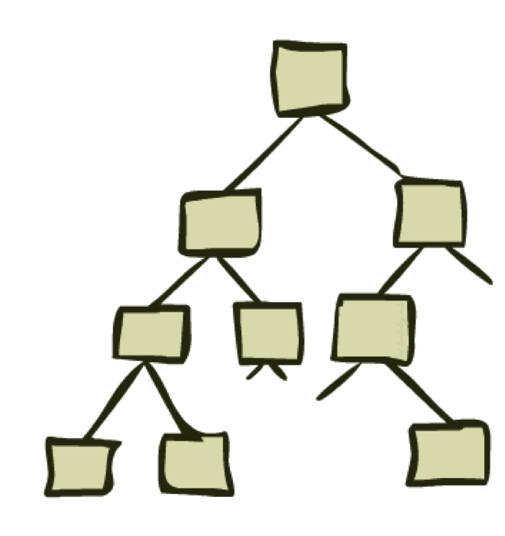
State Space Graphs and Search Trees

Slide 21
State Space Graphs
State space graph: A mathematical representation of a search problem
Notes:
Shown here is just a small part of the entire state space graph.

Slide 22
State Space Graphs
State space graph: A mathematical representation of a search problem
Nodes are (abstracted) world configurations
Arcs represent successors (action results)
The goal test is a set of goal nodes (maybe only one)

Slide 23
State Space Graphs
State space graph: A mathematical representation of a search problem
Nodes are (abstracted) world configurations
Arcs represent successors (action results)
The goal test is a set of goal nodes (maybe only one)
In a state space graph, each state occurs only once!

Slide 24
State Space Graphs
State space graph: A mathematical representation of a search problem
Nodes are (abstracted) world configurations
Arcs represent successors (action results)
The goal test is a set of goal nodes (maybe only one)
In a state space graph, each state occurs only once!
We can rarely build this full graph in memory (it’s too big), but it’s a useful idea

Slide 25
State Space Graphs
State space graph: A mathematical representation of a search problem
Nodes are (abstracted) world configurations
Arcs represent successors (action results)
The goal test is a set of goal nodes (maybe only one)
In a search graph, each state occurs only once!
We can rarely build this full graph in memory (it’s too big), but it’s a useful idea
a
G
b
c
e
d
f
S
h
p
q
r
Tiny search graph for a tiny search problem
Notes:
Important: In state space graphs we don’t repeat states that we’ve already seen.

Slide 26
Search Trees
This is now / start
Notes:
Different plans that achieve the same state, will be different nodes in the tree.

Slide 27
Search Trees
This is now / start
“N”, 1.0
“E”, 1.0
Possible futures
Notes:
One step into the future shows the second level of the tree.
These are the actions we can take from the starting state, and their costs.
Each of these branch into all of their possible successor states.

Slide 28
Search Trees
This is now / start
“N”, 1.0
“E”, 1.0
Possible futures
A search tree:
A “what if” tree of plans and their outcomes
The start state is the root node
Children correspond to successors
Nodes show states, but correspond to PLANS that achieve those states
For most problems, we can never actually build the whole tree
Notes:
Each node in the search tree encodes a path through the state space from the root to a certain state. If the node is the goal state, then we have a plan, a solution to the search problem.

Slide 29
State Space Graphs vs. Search Trees
State Space Graph
Each NODE in in the search tree is an entire PATH in the state space graph.
Search Tree
S
a
G
d
e
p
b
c
q
b
c
e
h
r
d
e
f
a
a
h
r
p
q
f
S
h
We construct both on demand – and we construct as little as possible.
p
q
f
q
c
G
p
q
r
q
c
G
a
a

Slide 30
Quiz: State Space Graphs vs. Search Trees
Consider this 4-state graph:
How big is its search tree (from S)?
a
S
G
b

Slide 31

Quiz: State Space Graphs vs. Search Trees
Consider this 4-state graph:
How big is its search tree (from S)?
a
S
G
b
Important: Lots of repeated structure in the search tree!

Slide 32
Tree Search

Slide 33
Search Example: Romania
Notes:
Suppose we want to get from Arad to Bucharest as quickly as possible.

Slide 34
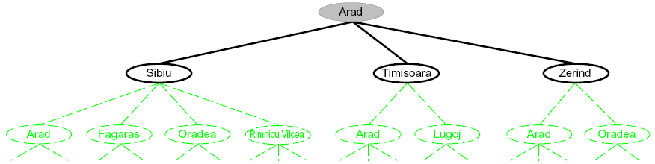
Searching with a Search Tree
Search:
Expand out potential plans (tree nodes)
Maintain a fringe of partial plans under consideration
Try to expand as few tree nodes as possible
Notes:
Three partial search trees for finding a route from Arad to Bucharest. Nodes
that have been expanded are gray; nodes on the frontier that have been
generated but not yet expanded are inside black ovals; the set of states corresponding to these two
types of nodes are said to have been reached. Nodes that could be generated next are shown
in dashed green ovals.

Slide 35
Searching with a Search Tree
Search:
Expand out potential plans (tree nodes)
Maintain a fringe of partial plans under consideration
Try to expand as few tree nodes as possible
Notes:
Notice in the bottom tree there is a cycle from Arad to Sibiu to Arad;
that can’t be an optimal path, so search should not continue from there.

Slide 36
General Tree Search
Important ideas:
Fringe
Expansion
Exploration strategy
Main question: which fringe nodes to explore?
Notes:
The search strategies we cover today are three ways to carry out general tree search.

Slide 37
Example: Tree Search
a
G
b
c
d
e
f
S
h
p
q
r
Notes:
Left: show tree
Right: fringe

Slide 38

Depth-First Search

Slide 39
Depth-First Search
Strategy: expand a deepest node first
Implementation: Fringe is a LIFO stack
a
G
b
c
d
e
f
S
h
p
q
r

Slide 40
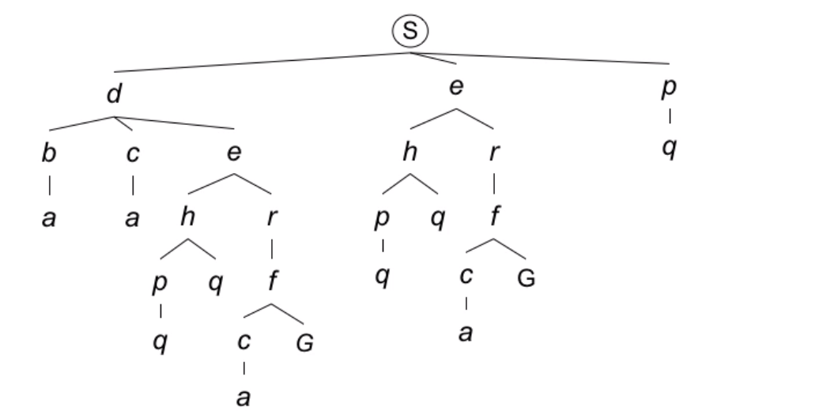
Depth-First Search
Strategy: expand a deepest node first
Implementation: Fringe is a LIFO stack
a
G
b
c
d
e
f
S
h
p
q
r

Slide 41
Depth-First Search
Strategy: expand a deepest node first
Implementation: Fringe is a LIFO stack
a
G
a
c
b
c
b
e
d
e
d
f
f
S
h
h
p
p
r
q
r
q
S
d
e
p
b
c
e
h
r
q
a
a
h
r
p
q
f
p
q
f
q
c
G
q
c
G
a
a

Slide 42
Depth-First Search
Strategy: expand a deepest node first
Implementation: Fringe is a LIFO stack
a
G
a
c
b
c
b
e
d
e
d
f
f
S
h
h
p
p
r
q
r
q
S
d
e
p
b
c
e
h
r
q
a
a
h
r
p
q
f
p
q
f
q
c
G
q
c
G
a
a

Slide 43
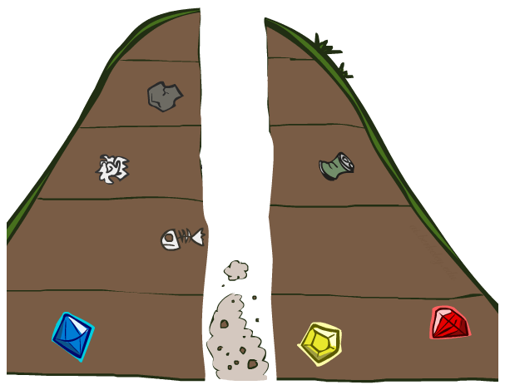
Search Algorithm Properties

Slide 44
Search Algorithm Properties
Complete: Guaranteed to find a solution if one exists?
Optimal: Guaranteed to find the least cost path?
Notes:
Yes, complete if the tree is finite.
No, not optimal.

Slide 45
Search Algorithm Properties
Complete: Guaranteed to find a solution if one exists?
Optimal: Guaranteed to find the least cost path?
Time complexity?
Space complexity?

Slide 46
Search Algorithm Properties
Complete: Guaranteed to find a solution if one exists?
Optimal: Guaranteed to find the least cost path?
Time complexity?
Space complexity?
Cartoon of search tree:
b is the branching factor
m is the maximum depth
solutions at various depths
Number of nodes in entire tree?
1 + b + b² + …. b^{m} = O(b^{m})
1 node
b
…
b nodes
b² nodes
m tiers
b^{m} nodes

Slide 47
Depth-First Search (DFS) Properties
What nodes DFS expand?
1 node
b
…
b nodes
b² nodes
m tiers
b^{m} nodes

Slide 48
Depth-First Search (DFS) Properties
What nodes DFS expand?
Some left prefix of the tree.
Could process the whole tree!
If m is finite, takes time O(b^{m})
1 node
b
…
b nodes
b² nodes
m tiers
b^{m} nodes

Slide 49
Depth-First Search (DFS) Properties
What nodes DFS expand?
Some left prefix of the tree.
Could process the whole tree!
If m is finite, takes time O(b^{m})
How much space does the fringe take?
1 node
b
…
b nodes
b² nodes
m tiers
b^{m} nodes

Slide 50
Depth-First Search (DFS) Properties
What nodes DFS expand?
Some left prefix of the tree.
Could process the whole tree!
If m is finite, takes time O(b^{m})
How much space does the fringe take?
Only has siblings on path to root, so O(bm)
1 node
b
…
b nodes
b² nodes
m tiers
b^{m} nodes

Slide 51
Depth-First Search (DFS) Properties
What nodes DFS expand?
Some left prefix of the tree.
Could process the whole tree!
If m is finite, takes time O(b^{m})
How much space does the fringe take?
Only has siblings on path to root, so O(bm)
Is it complete?
1 node
b
…
b nodes
b² nodes
m tiers
b^{m} nodes

Slide 52
Depth-First Search (DFS) Properties
What nodes DFS expand?
Some left prefix of the tree.
Could process the whole tree!
If m is finite, takes time O(b^{m})
How much space does the fringe take?
Only has siblings on path to root, so O(bm)
Is it complete?
m could be infinite, so only if we prevent cycles (more later)
1 node
b
…
b nodes
b² nodes
m tiers
b^{m} nodes

Slide 53
Depth-First Search (DFS) Properties
What nodes DFS expand?
Some left prefix of the tree.
Could process the whole tree!
If m is finite, takes time O(b^{m})
How much space does the fringe take?
Only has siblings on path to root, so O(bm)
Is it complete?
m could be infinite, so only if we prevent cycles (more later)
Is it optimal?
1 node
b
…
b nodes
b² nodes
m tiers
b^{m} nodes

Slide 54
Depth-First Search (DFS) Properties
What nodes DFS expand?
Some left prefix of the tree.
Could process the whole tree!
If m is finite, takes time O(b^{m})
How much space does the fringe take?
Only has siblings on path to root, so O(bm)
Is it complete?
m could be infinite, so only if we prevent cycles (more later)
Is it optimal?
No, it finds the “leftmost” solution, regardless of depth or cost
1 node
b
…
b nodes
b² nodes
m tiers
b^{m} nodes

Slide 55
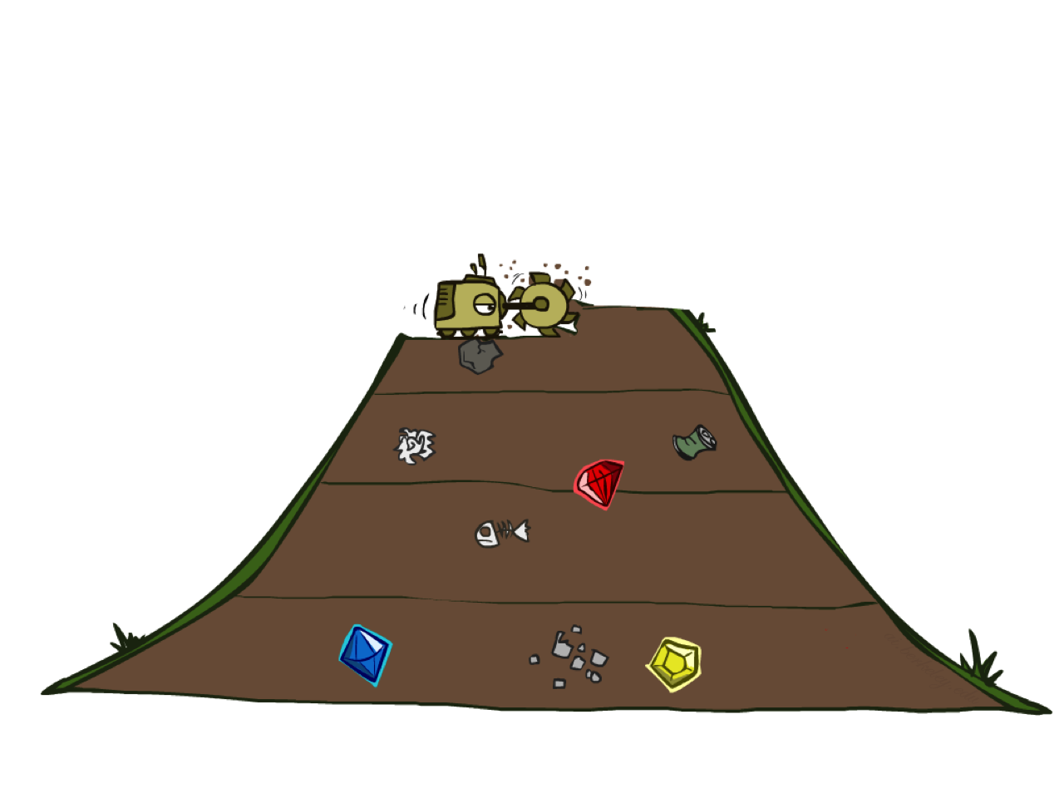
Breadth-First Search

Slide 56
Breadth-First Search
Strategy: expand a shallowest node first
Implementation: Fringe is a FIFO queue
a
G
b
c
d
e
f
S
h
p
q
r

Slide 57
Breadth-First Search
Strategy: expand a shallowest node first
Implementation: Fringe is a FIFO queue
a
G
b
c
d
e
f
S
h
p
q
r

Slide 58
Breadth-First Search
Strategy: expand a shallowest node first
Implementation: Fringe is a FIFO queue
a
G
b
c
d
e
f
S
h
p
q
r
S
d
e
p
Search
Tiers
b
c
e
h
r
q
a
a
h
r
p
q
f
p
q
f
q
c
G
q
c
G
a
a

Slide 59
Breadth-First Search (BFS) Properties
What nodes does BFS expand?
1 node
b
…
b nodes
s tiers
b² nodes
b^{s} nodes
b^{m} nodes

Slide 60
Breadth-First Search (BFS) Properties
What nodes does BFS expand?
Processes all nodes above shallowest solution
Let depth of shallowest solution be s
Search takes time O(b^{s})
1 node
b
…
b nodes
s tiers
b² nodes
b^{s} nodes
b^{m} nodes

Slide 61
Breadth-First Search (BFS) Properties
What nodes does BFS expand?
Processes all nodes above shallowest solution
Let depth of shallowest solution be s
Search takes time O(b^{s})
How much space does the fringe take?
1 node
b
…
b nodes
s tiers
b² nodes
b^{s} nodes
b^{m} nodes

Slide 62
Breadth-First Search (BFS) Properties
What nodes does BFS expand?
Processes all nodes above shallowest solution
Let depth of shallowest solution be s
Search takes time O(b^{s})
How much space does the fringe take?
Has roughly the last tier, so O(b^{s})
1 node
b
…
b nodes
s tiers
b² nodes
b^{s} nodes
b^{m} nodes

Slide 63
Breadth-First Search (BFS) Properties
What nodes does BFS expand?
Processes all nodes above shallowest solution
Let depth of shallowest solution be s
Search takes time O(b^{s})
How much space does the fringe take?
Has roughly the last tier, so O(b^{s})
Is it complete?
1 node
b
…
b nodes
s tiers
b² nodes
b^{s} nodes
b^{m} nodes

Slide 64
Breadth-First Search (BFS) Properties
What nodes does BFS expand?
Processes all nodes above shallowest solution
Let depth of shallowest solution be s
Search takes time O(b^{s})
How much space does the fringe take?
Has roughly the last tier, so O(b^{s})
Is it complete?
s must be finite if a solution exists, so yes!
1 node
b
…
b nodes
s tiers
b² nodes
b^{s} nodes
b^{m} nodes

Slide 65
Breadth-First Search (BFS) Properties
What nodes does BFS expand?
Processes all nodes above shallowest solution
Let depth of shallowest solution be s
Search takes time O(b^{s})
How much space does the fringe take?
Has roughly the last tier, so O(b^{s})
Is it complete?
s must be finite if a solution exists, so yes!
Is it optimal?
1 node
b
…
b nodes
s tiers
b² nodes
b^{s} nodes
b^{m} nodes

Slide 66
Breadth-First Search (BFS) Properties
What nodes does BFS expand?
Processes all nodes above shallowest solution
Let depth of shallowest solution be s
Search takes time O(b^{s})
How much space does the fringe take?
Has roughly the last tier, so O(b^{s})
Is it complete?
s must be finite if a solution exists, so yes!
Is it optimal?
Only if costs are all 1 (more on costs later)
1 node
b
…
b nodes
s tiers
b² nodes
b^{s} nodes
b^{m} nodes

Slide 67
Quiz: DFS vs BFS

Slide 68
Quiz: DFS vs BFS
When will BFS outperform DFS?
When will DFS outperform BFS?
Notes:
BFS outperforms when the goal is shallow and on the side DFS searches last.
DFS outperforms when the goal is deep and on the side DFS searches first.

Slide 69

Video of Demo Maze Water DFS/BFS (part 1)
Notes:
Which is it? DFS or BFS?

Slide 70
Video of Demo Maze Water DFS/BFS (part 2)
Notes:
Which is it? DFS or BFS?

Slide 71
Iterative Deepening
Idea: get DFS’s space advantage with BFS’s time / shallow-solution advantages
Run a DFS with depth limit 1. If no solution…
Run a DFS with depth limit 2. If no solution…
Run a DFS with depth limit 3. …..
Isn’t that wastefully redundant?
Generally most work happens in the lowest level searched, so not so bad!
b
…

Slide 72
Cost-Sensitive Search
a
GOAL
2
2
b
c
3
2
1
8
2
e
d
f
3
9
8
2
START
h
1
4
2
p
4
r
15
q
BFS finds the shortest path in terms of number of actions.
It does not find the least-cost path. We will now cover
a similar algorithm which does find the least-cost path.
Notes:
Uniform cost search (sometimes called Dijkstra’s algorithm).

Slide 73

Uniform Cost Search

Slide 74
Uniform Cost Search
2
G
a
Strategy: expand a cheapest node first:
Fringe is a priority queue (priority: cumulative cost)
b
c
1
8
2
2
e
3
d
f
9
8
2
S
h
1
1
p
q
r
15
0
S
d
3
e
9
p
1
b
4
e
5
h
17
r
11
q
16
c
11
Cost contours
a
6
a
h
13
r
7
p
q
f
p
q
f
8
q
c
G
q
c
a
11
G
10
a

Slide 75
Uniform Cost Search (UCS) Properties
What nodes does UCS expand?
Processes all nodes with cost less than cheapest solution!
If that solution costs C* and arcs cost at least  , then the “effective depth” is roughly C*/
Takes time O(b^{C*/}) (exponential in effective depth)
How much space does the fringe take?
Has roughly the last tier, so O(b^{C*/})
Is it complete?
Assuming best solution has a finite cost and minimum arc cost is positive, yes!
Is it optimal?
Yes! (Proof next lecture via A*)
b
c  1
…
C*/ “tiers”
c  2
c  3

Slide 76
Uniform Cost Issues
Remember: UCS explores increasing cost contours
The good: UCS is complete and optimal!
The bad:
Explores options in every “direction”
No information about goal location
We’ll fix that soon!
…
c  1
c  2
c  3
Start
Goal
[Demo: empty grid UCS (L2D5)]
[Demo: maze with deep/shallow water DFS/BFS/UCS (L2D7)]

Slide 77
Video of Demo Empty UCS

Slide 78
Video of Demo Maze with Deep/Shallow Water --- DFS, BFS, or UCS? (part 1)
Notes:
Let students guess which one of the three it is. (This is BFS.)

Slide 79
Video of Demo Maze with Deep/Shallow Water --- DFS, BFS, or UCS? (part 2)
Notes:
Let students guess which one of the three it is. (This is UCS.)

Slide 80
Video of Demo Maze with Deep/Shallow Water --- DFS, BFS, or UCS? (part 3)
Notes:
Let students guess which one of the three it is. (This is DFS.)

Slide 81

The One Queue
All these search algorithms are the same except for fringe strategies
Conceptually, all fringes are priority queues (i.e. collections of nodes with attached priorities)
Practically, for DFS and BFS, you can avoid the log(n) overhead from an actual priority queue by using stacks and queues
Can even code one implementation that takes a variable queuing object

Slide 82
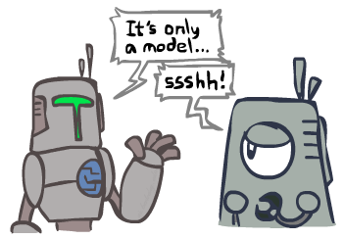
Search and Models
Search operates over models of the world
The agent doesn’t actually try all the plans out in the real world!
Planning is all “in simulation”
Your search is only as good as your models…

Slide 83
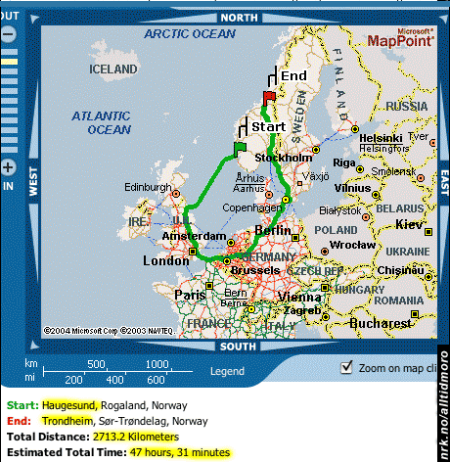
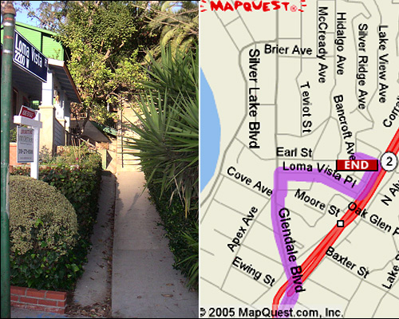

Search Gone Wrong?

Slide 84
Some Hints for P1
Graph search is almost always better than tree search (when not?)
Implement your closed list as a dict or set!
Nodes are conceptually paths, but better to represent with a state, cost, last action, and reference to the parent node

